Slide 1



YouTube Comment Sentiment Analysis
3rd December 2019
26th November 2019
Vishaal Venkatesh

Slide 2
Goals…
Is the general sentiment of comments under videos indicative of the L/D ratio a video has? Is this a good/strong predictive metric?
Specific analysis on controversial channels (e.g. Logan Paul).
Build my own sentiment analysis tool and compare performance with VADER – time permitting.

Slide 3
About the Datasets – Video Dataset
We use two datasets – one on videos and other on comments.
Videos are from 13th Sep to 22nd Oct of 2017. In all, ~8000 video titles.
However, ~2/3 of them were duplicates… (copyright and/or violations of YouTube’s policies.)

Slide 4
Video Dataset – Duplicates
I took the final upload and removed other duplicates… we now have ~2300 video titles.

Slide 5
Comments Dataset
~700,000 comments – complete with expletives and emoticons!
Here’s a carefully sampled assortment:

Slide 6
VADER – An Introduction
Stands for Valence Aware Dictionary for sEntiment Reasoning.
Sensitive to both polarity and strength of emotion
Gives you four scores – Positive, Neutral, Negative and Compound.
Accounts for punctuations and emojis!

Slide 7
VADER - Examples…. Oh yeahhh!!
The most positive comments with a score of 1.0 !!
Comments with score -1.0! I simply cannot show you those…
Comments with -0.9!

Slide 8
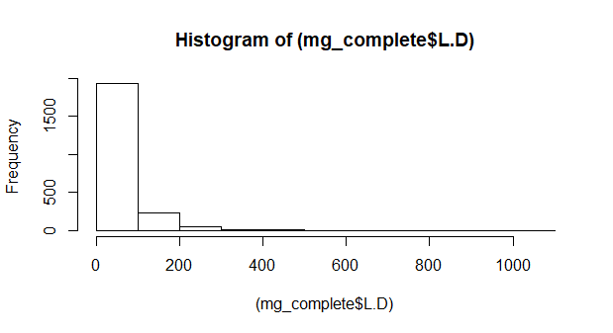
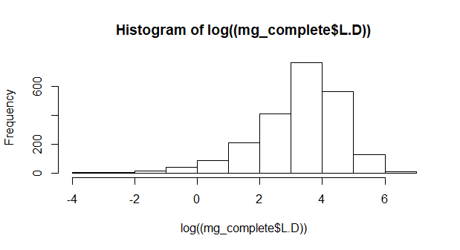
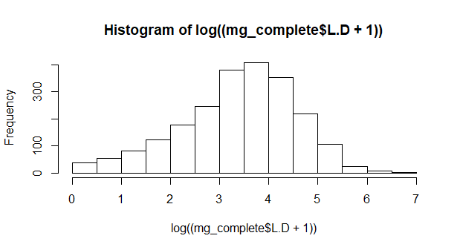
Normality Adventures

Slide 9
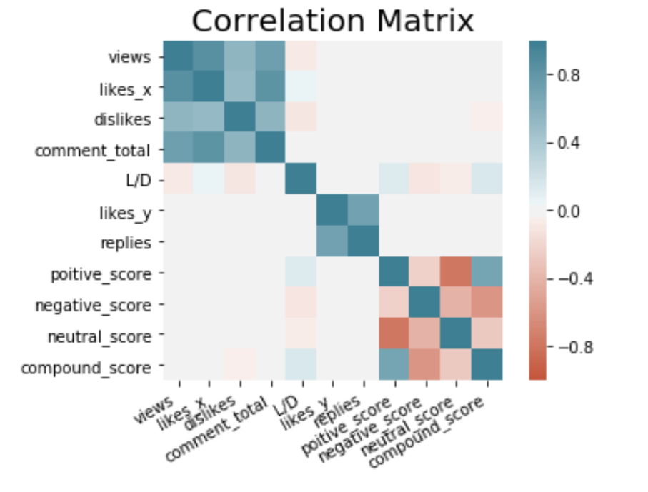
EDA…

Slide 10
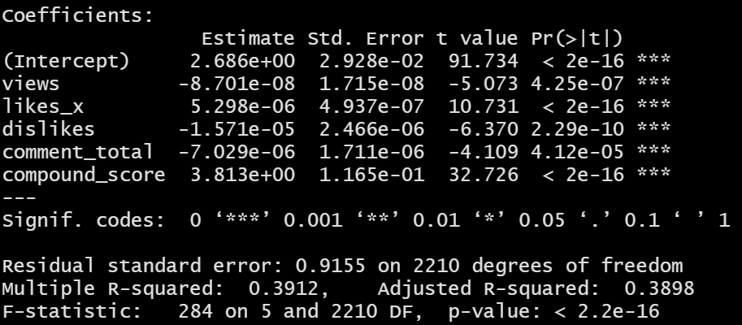
Model…
ln(L/D + 1) ~ views + likes + dislikes + comment_total + compound_score
An increase of 0.01 to the compound score resulted in an increase of 0.04 in the L/D of ratio.

Slide 11
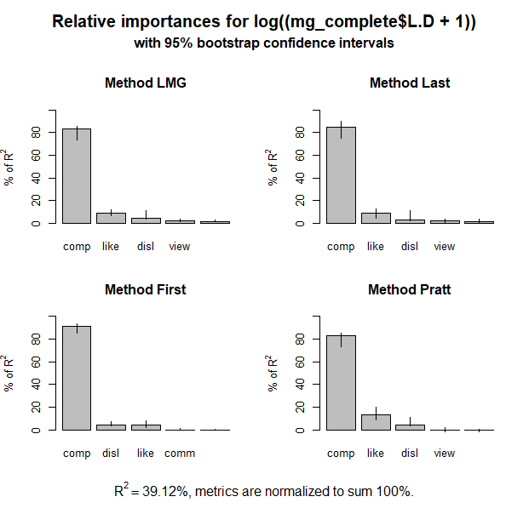

Slide 12
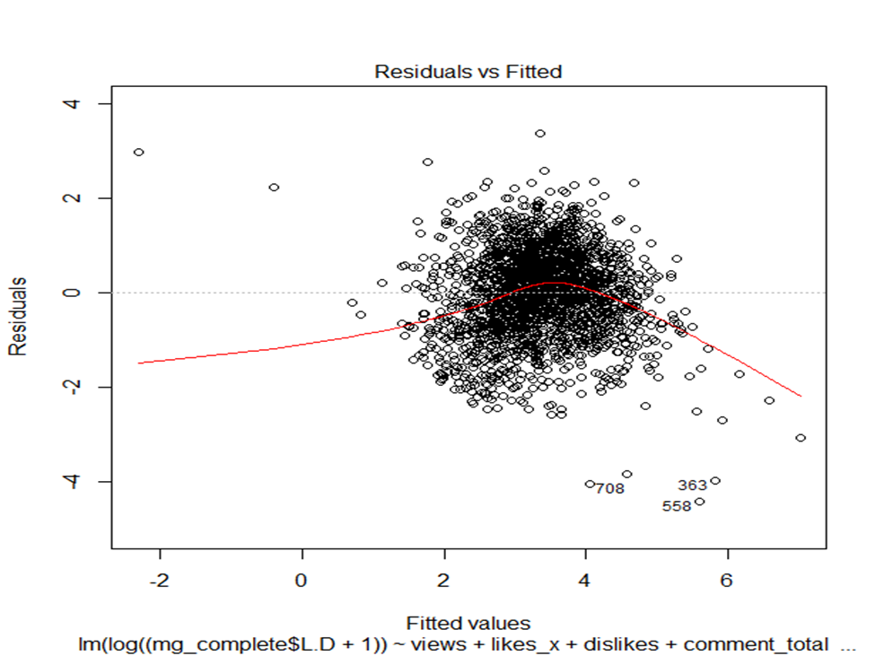

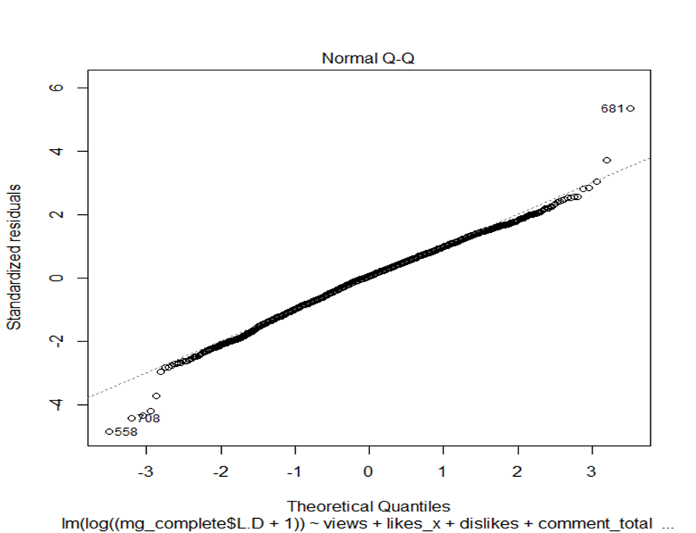
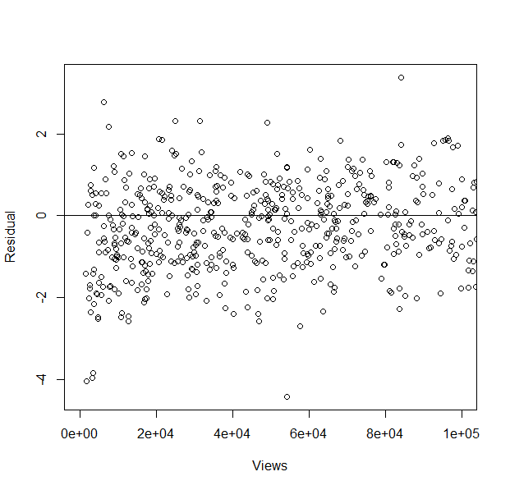
Diagnostics…
No obvious pattern… linearity assumption met.
Homoscedastic, but hard to say if it’s entirely random… so may not be independent?

Slide 13
Future Work…
1
3
2
Potentially use a hierarchical model.
Study controversial channels - (Logan Paul etc.)
Build my own sentiment analysis tool and compare performance with VADER – time permitting.

Slide 14
Thank You!

